Slide 1
Task-oriented interactions in Microsoft Teams with messaging extensions

Slide 2
Messaging extensions overview
Action commands
Creating action commands

Slide 3
Microsoft Teams Messaging Extensions

Slide 4
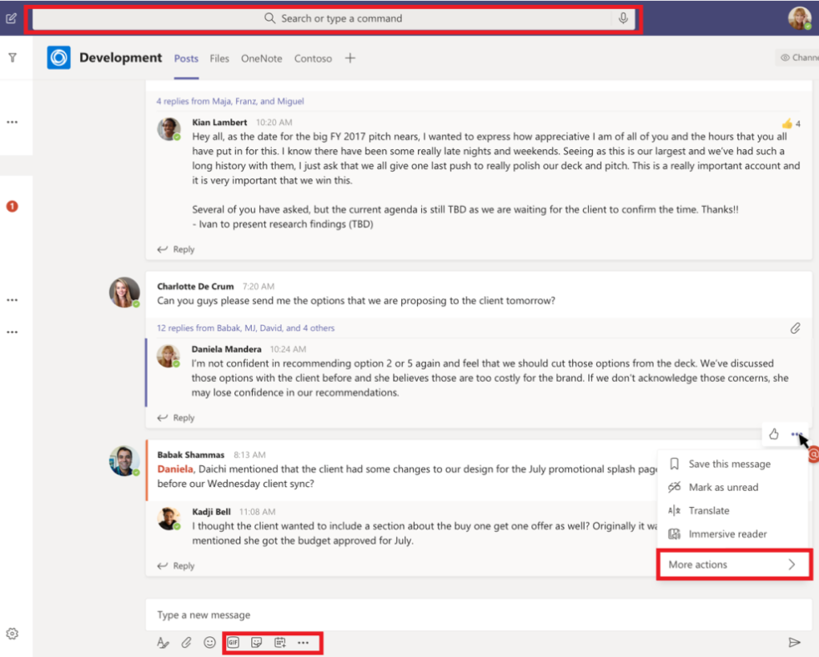
What are Microsoft Teams messaging extensions?
Enable users to interact with a web service through buttons and forms in the Microsoft Teams client
Invoke actions
Execute search queries
Expand URLs with additional detail

Slide 5
Messaging extension scenarios
Perform action in external systems & include results in conversation
Complete complex task involving multiple steps and share results

Slide 6
How they work
Can be invoked from one of the following locations in Microsoft Teams:
Command box
Compose message box
Message’s “More Actions” menu
Implemented as web services
Microsoft Teams communicates with the web service through the Bot Framework
Messaging extensions are registered as bots with the Bot Framework
Web service responds with task modules or richly formatted cards

Slide 7
Types of messaging extensions
Action commands
Present user with a task module to collection information and act on it
Optionally respond with another task module, plain text message or richly formatted adaptive card
Search commands
Enable user to search external system from the command box or compose message box

Slide 8
Developing action commands
Action commands can be triggered from the following locations:
Command box
Compose message box
Message’s context menu
When invoked, JSON payload sent to the registered web service
Web service responds with task module implemented with web interface or adaptive card

Slide 9
Register action command messaging extensions in the app manifest
"composeExtensions": [{
"botId": "<REPLACE_WITH_MICROSOFT_APP_ID>",
"canUpdateConfiguration": false,
"commands": [{
"id": "planetExpanderAction",
"type": "action",
"title": "Planet Expander",
"description": "Lookup the details of a planet.",
"context": [ "compose", "message"],
"parameters": [...],
"fetchTask": true
}]
}
]

Slide 10
How will the action command respond?
Decide how the message will be set back to the user
Insert message in the compose message box?
Respond directly to a conversation?
When responding directly to conversation, must also register the web service as a bot in the app manifest
If responding directly to conversation, can update / delete the message later via the bot

Slide 11
Create and send the task module when the action command is invoked
// handle the Activity type = “composeExtension/fetchTask”
export class PlanetBot extends TeamsActivityHandler { protected handleTeamsMessagingExtensionFetchTask(context: TurnContext, action: MessagingExtensionAction ): Promise<MessagingExtensionActionResponse> {
const adaptiveCard = CardFactory.adaptiveCard(require("./planetSelectorCard.json"));
let response: MessagingExtensionActionResponse = <MessagingExtensionActionResponse>{
task: {
type: "continue",
value: { card: adaptiveCard, title: 'Planet Selector’, height: 150, width: 500 }
}};
return Promise.resolve(response);
}}

Slide 12
Handling the messaging extension task module submission
// handle the Activity type = “composeExtension/submitAction”
export class PlanetBot extends TeamsActivityHandler {
protected handleTeamsMessagingExtensionSubmitAction(context: TurnContext,
action: MessagingExtensionAction ): Promise<MessagingExtensionActionResponse> {
switch (action.commandId) {
case 'planetExpanderAction':
const adaptiveCard = this.getPlanetDetailCard(action.data.planetSelector);
return Promise.resolve(<MessagingExtensionActionResponse>{
composeExtension: { type: "result", attachmentLayout: "list", attachments: [adaptiveCard] } }
);
break;
default:
throw new Error('NotImplemented');
}
} }

Slide 13
DEMO
Create action command messaging extensions

Slide 14
Search commands
Creating search commands

Slide 15
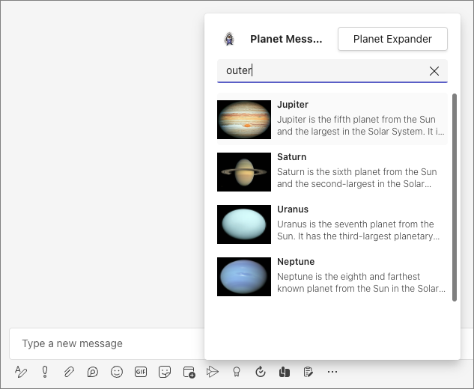
What are search commands?
Action commands enable users to search an external system for information
Search query is sent from Microsoft Teams to your web service
Your web service responds with a list or grid of results
When a user selects a result, it is added to the compose message box as a card or text

Slide 16
Register search command messaging extensions in the app manifest
"composeExtensions": [{
"botId": "<REPLACE_WITH_MICROSOFT_APP_ID>",
"canUpdateConfiguration": false,
"commands": [{
"id": "planetExpanderSearch",
"type": "query",
"title": "Planet Lookup",
"description": "Search for a planet.",
"context": [ "compose"],
"parameters": [{ title: "Planet", name: "searchKeyword",
description: "Enter ‘inner’, ‘outer’, or planet name" }],
}]
}]

Slide 17
Responding to search command queries
export class PlanetBot extends TeamsActivityHandler {
protected handleTeamsMessagingExtensionQuery(context, query): Promise<MessagingExtensionResponse> {
// get the search query
let searchQuery = query.parameters[0].value.trim().toLowerCase();
// execute search logic
let queryResults: string[] = ...;
// get results as cards
let cards: MessagingExtensionAttachment[] = [];
queryResults.forEach((planet) => {
cards.push(this.getPlanetResultCard(planet));
});
let response: MessagingExtensionResponse = <MessagingExtensionResponse>{
composeExtension: { type: "result", attachmentLayout: "list", attachments: cards } };
return Promise.resolve(response);
}
}

Slide 18
DEMO
Create search command messaging extensions

Slide 19
Link unfurling

Slide 20
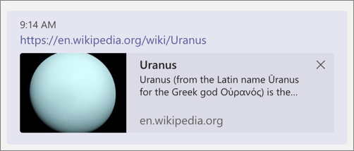
What is link unfurling?
Configure your messaging extension to watch for specific URLs in the compose message box
When a registered domain is detected, the message is sent to your web service
Web service responds with a richly formatted card, similar to search results
Notes:
With link unfurling your app can register to receive an `invoke` activity when URLs with a particular domain are pasted into the compose message area. The `invoke` will contain the full URL that was pasted into the compose message area, and you can respond with a card the user can unfurl, providing additional information or actions. This works similarly to a search command, with the URL serving as the search term.

Slide 21
Register link unfurling messaging extensions in the app manifest
"composeExtensions": [
{
"botId": "<REPLACE_WITH_MICROSOFT_APP_ID>",
"canUpdateConfiguration": false,
"messageHandlers": [
{
"type": "link",
"value": { "domains": [ "*.wikipedia.org” ]
}
]
}
],
"validDomains": [ "{{HOSTNAME}}", "*.wikipedia.org” ]
Notes:
Adding a link unfurling messaging extension follows a similar process as action commands and search commands. You'll first register domain(s) supported by your messaging extension and then implement the handler in your web service.
The first step is to register your link unfurling messaging extension in your Microsoft Teams app manifest file. Do this by adding an entry to the `messageHandlers` property on the `composeExtensions` property.
The `type` property must be set to `link`.
The `value` property must contain a `domains` collection of domains that the link message handler watches for. If a link is added to a message that matches a domain listed in this collection, the message handler is invoked.
In addition to the `messageHandlers` property, all domains must also be listed in the `validDomains` property of the Microsoft Teams app's manifest.

Slide 22
Responding to message handler invocation
// handle the Activity type = “composeExtension/queryLink”
export class PlanetBot extends TeamsActivityHandler {
protected handleTeamsAppBasedLinkQuery(context: TurnContext, query: AppBasedLinkQuery
): Promise<MessagingExtensionResponse> {
// get the selected planet
const selectedPlanet: any = planets.filter((planet) => planet.wikiLink === query.url)[0];
const adaptiveCard = this.getPlanetDetailCard(selectedPlanet);
// generate the response
return Promise.resolve(<MessagingExtensionActionResponse>{
composeExtension: {
type: "result", attachmentLayout: "list", attachments: [adaptiveCard]
}
});
} }
Notes:
When a valid domain is detected by the Microsoft Teams client, the Bot Framework will send an `Activity` object to your web service of type `composeExtension/queryLink` with the URL from the message.
Your web service will respond with a similar response as the search command. However, if you return multiple attachments, only the first one in the collection will be used by the Microsoft Teams client

Slide 23
DEMO
Link unfurling

